Slide 1

DEPARTMENT OF COMPUTER SCIENCE AND ENGINEERING
Project name : Smart Public Restroom
Team name : project_224780_Team_5
Team members :
KAVIYA .S (113321104042)
KEERTHANA .M (113321104043)
KEERTHANA.M (113321104044)
KEERTHIKA.C (113321104045)

Slide 2
Introduction:
There are over 100 Million Urban Poor living in Indian cities, who rely on public toilets. However, a large number of these toilets are today in a bad state, unusable. Smart Public Toilet is an IoT and AI-enabled governance platform that enables Urban Local Bodies and schools to improve toilet cleaning and standardization of toilet hygiene.
Creating a smart public restroom involves integrating IoT devices and a platform to enhance the restroom's functionality, improve maintenance, and provide a better user experience. Here's a brief overview of the objectives, IoT device setup, platform development, and code implementation, along with diagrams, schematics, and screenshots for clarity.
Creating a smart public restroom using IoT (Internet of Things) involves a combination of hardware, software, and connectivity. While web development technologies may not be the only requirement, they can play a crucial role in creating a user interface for monitoring and controlling the smart restroom system.

Slide 3
Description:
The Goal of the system is to monitor and evaluates Toilet Condition In Real-Time, enabling city governments to improve the toilet cleaning & upkeep through:
Monitoring capabilities
Actionable intelligence
Engagement & behavior change
Standardization of toilet hygiene
To achieve this goal, We have to monitor 1.Number of Male/ Female using toilets 2.Water Usage and Level monitoring 3.The smell in the toilet.
Light/ Darkness in the Toilet
User Feedback from the Toilet.

Slide 4
Objective:
The objective of a smart public restroom is to:
Enhance User Experience: Provide a clean, safe, and comfortable environment for users.
Improve Maintenance: Enable real-time monitoring to ensure cleanliness, stock levels, and equipment functionality.
Water and Energy Efficiency: Optimize resource usage by reducing wastage.
Data-Driven Decision-Making: Collect and analyze data to make informed decisions for restroom management.

Slide 5
Web development technologies:
Front-End: You can use HTML, CSS, and JavaScript for creating a web based dashboard or user interface. Frameworks like React, Angular, or Vue.js can simplify the development process.
Back-End: You might need a server to handle data processing, user authentication, and other backend functionalities. You can use Node.js, Python, Ruby, or any other server- side technology.
Databases: Use databases (e.g., MySQL, PostgreSQL, MongoDB) to store and retrieve
data.
APIs: Create APIs to connect the front-end and back-end. RESTful or Graph QL APIs are common choices.

Slide 6
Platform required:
Hardware for IoT: You'll need various IoT devices and sensors to collect data from the restroom. This might include occupancy sensors, water quality sensors, temperature sensors, and more. These devices will gather data about the restroom's condition and usage.
IoT Communication Protocols: To connect the IoT devices to the web, you'll need communication protocols such as MQTT, CoAP, or HTTP(S) for data transmission.
Microcontrollers and IoT Development Boards: You might use platforms like Arduino, Raspberry Pi, or specialized IoT development boards to control and manage the IoT devices.
Internet Connectivity: You need a stable internet connection for the IoT devices to send and receive data. This could be through Wi-Fi, Ethernet, or cellular connectivity.
IoT Cloud Platform: You'll need a cloud platform like AWS IoT, Google Cloud IoT, or Microsoft Azure IoT to manage the data collected from the IoT devices. These platforms provide tools for data storage, processing, and management.

Slide 7
SMART PRODUCTS TO EQUIP RESTROOMS:
AVAILABILITY INDICATORS: By means of red and green light, indicators notify washroom users on cubicles availability, which, in turn, reduces congestion. Since it is not always clear whether there is a free cubicle, there might occur situations when stalls remain unoccupied while there is a long line and nobody wants to leave the queue to check if all the stalls are indeed occupied. Therefore, these indicators prevent such cases and release of the necessity to knock or to try doors.
SOAP DISPENSER: A smart internet-connected dispenser that ensures there is always enough soap for restroom users. It also helps avoid soap wastage by emitting the exact amount of soap a person needs to wash hands.
SMART TAP: A touch-free tap ensures washroom users are protected from Legionella bacteria. The tap monitors water and pipes temperature and condition to alert the supervisor in case there is a risk of Legionella development.
SMART CLEANING SYSTEM: The system injects a portion of biocidal substance with every flush to kill bacteria and odors. Besides, the system can provide workers with information about use frequency and even the amount of toilet paper left.

Slide 8
IoT Device Setup:
Key IoT devices to implement in a smart public restroom include:
Smart Sensors: Install occupancy sensors, water flow sensors, and temperature sensors to monitor restroom conditions.
Smart Dispensers: Use IoT-enabled soap dispensers, paper towel dispensers, and air hand dryers.
Smart Locks: Employ IoT locks for restroom access control.
Security Cameras: Install surveillance cameras for security and monitoring.
Water Management System: Implement smart faucets and flush valves to control water usage.

Slide 9
Platform Development:
Develop a centralized platform to manage and monitor the IoT devices. Here's an outline:
Data Aggregation: Collect data from IoT devices, including occupancy status, consumable levels, and water usage.
Data Analytics: Utilize data analytics to identify usage patterns, predict maintenance needs, and optimize resource consumption.
User Interface: Create a user-friendly web or mobile interface for users to locate and access the smart restroom.
Alerts and Notifications: Implement real-time alerts and notifications for maintenance staff and managers.
Access Control: Manage restroom access, allowing authorized users to enter using an app or access card.
Remote Control: Enable remote control of devices, such as locking/unlocking doors and adjusting water flow.

Slide 10
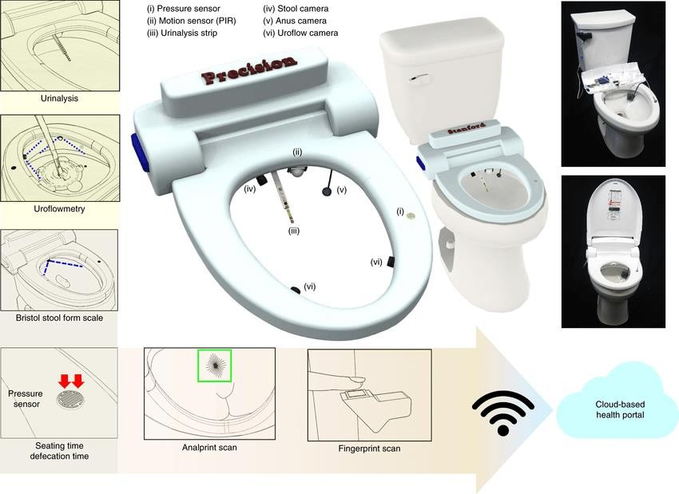
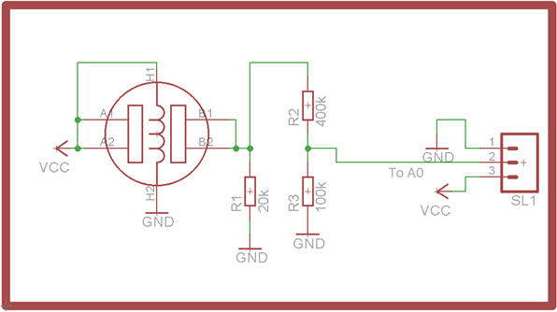
Diagram and Schematics:
Create a system architecture diagram showing how devices connect to the platform. Include schematics for the IoT devices' connectivity and power sources.

Slide 11
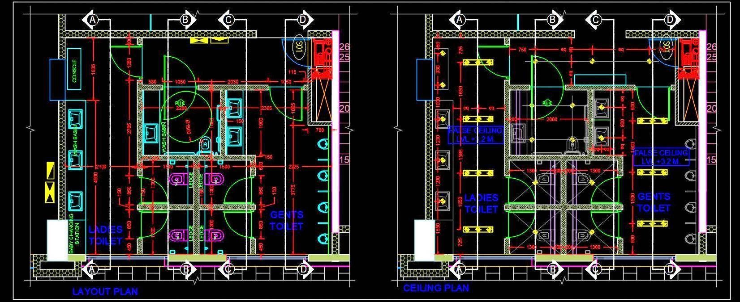
Public Toilet and Ceiling Plan Cad DWG Detail:

Slide 12
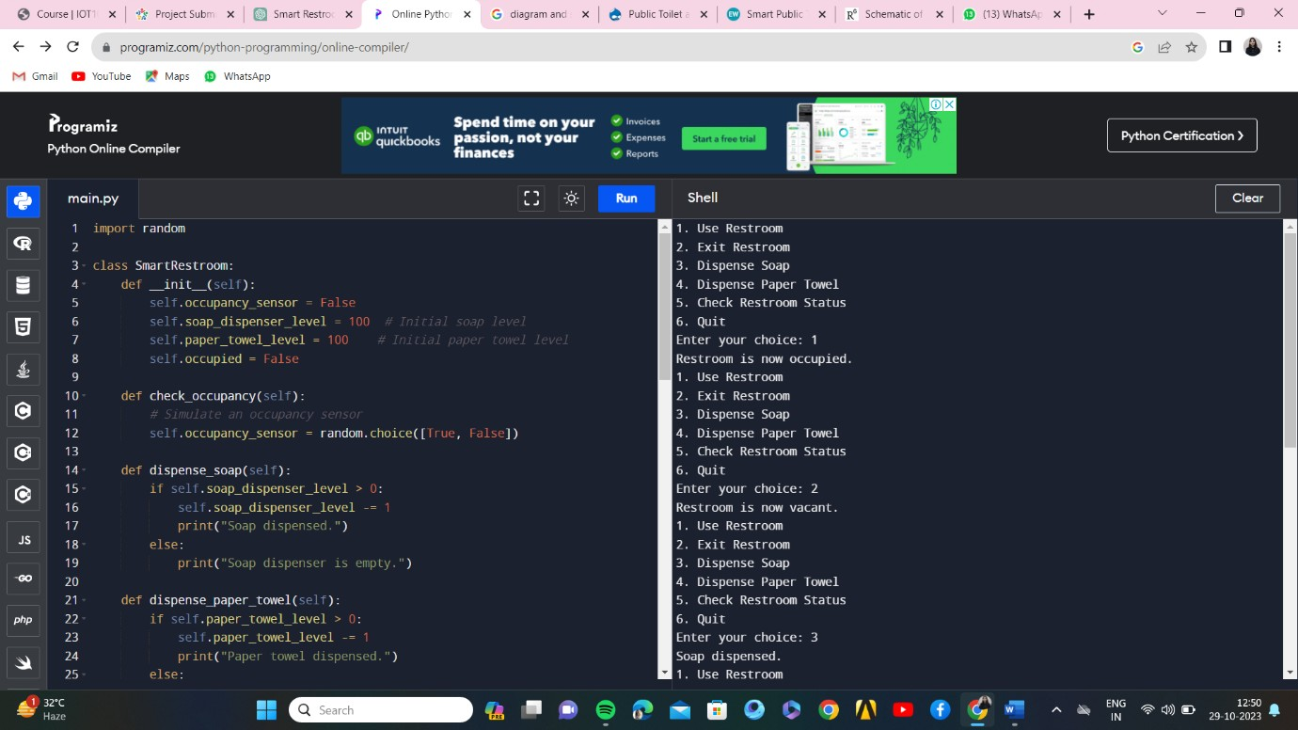
SCREENSHOT OF PYTHON CODE OUTPUT:

Slide 13
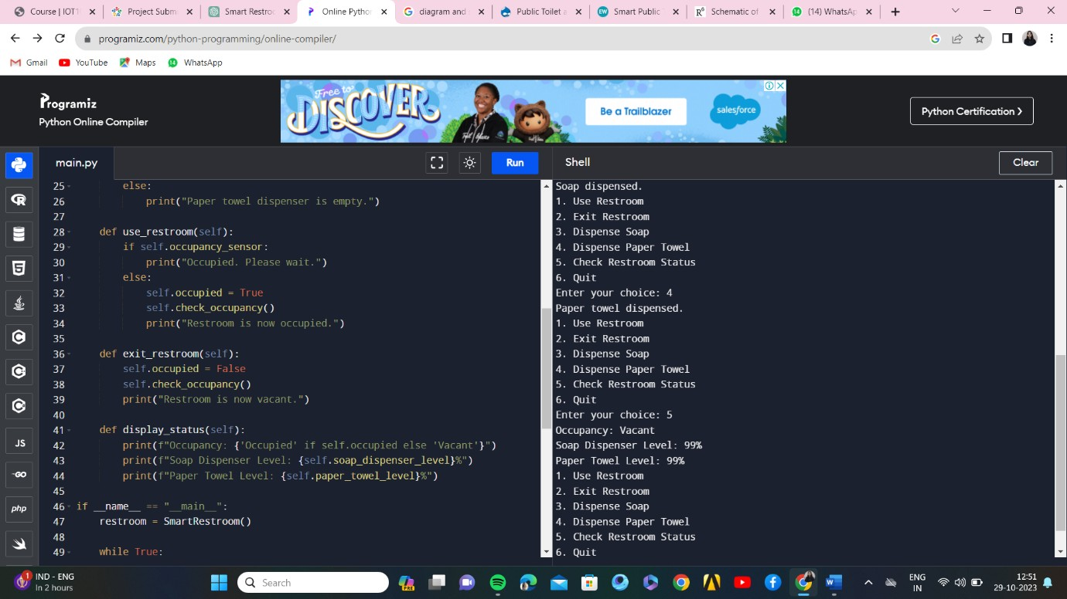

Slide 14
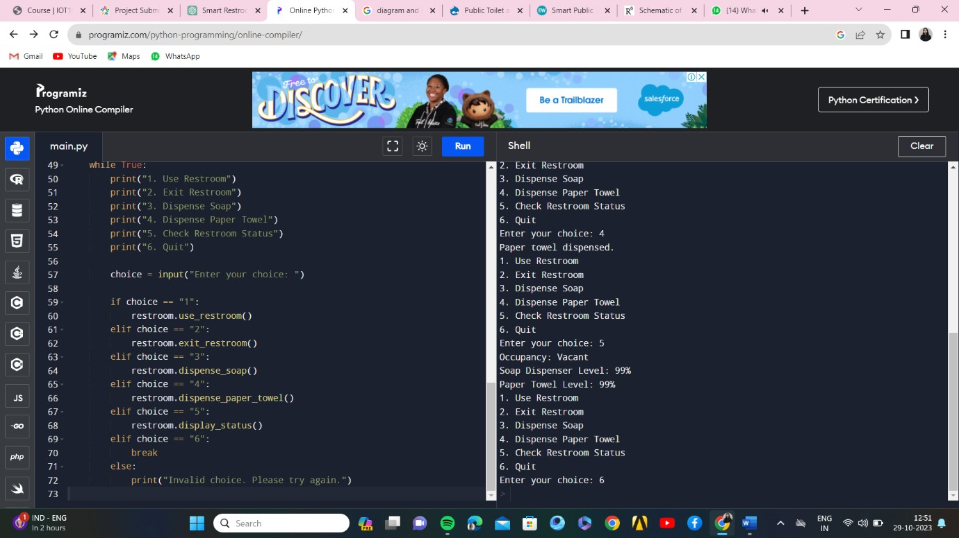

Slide 15
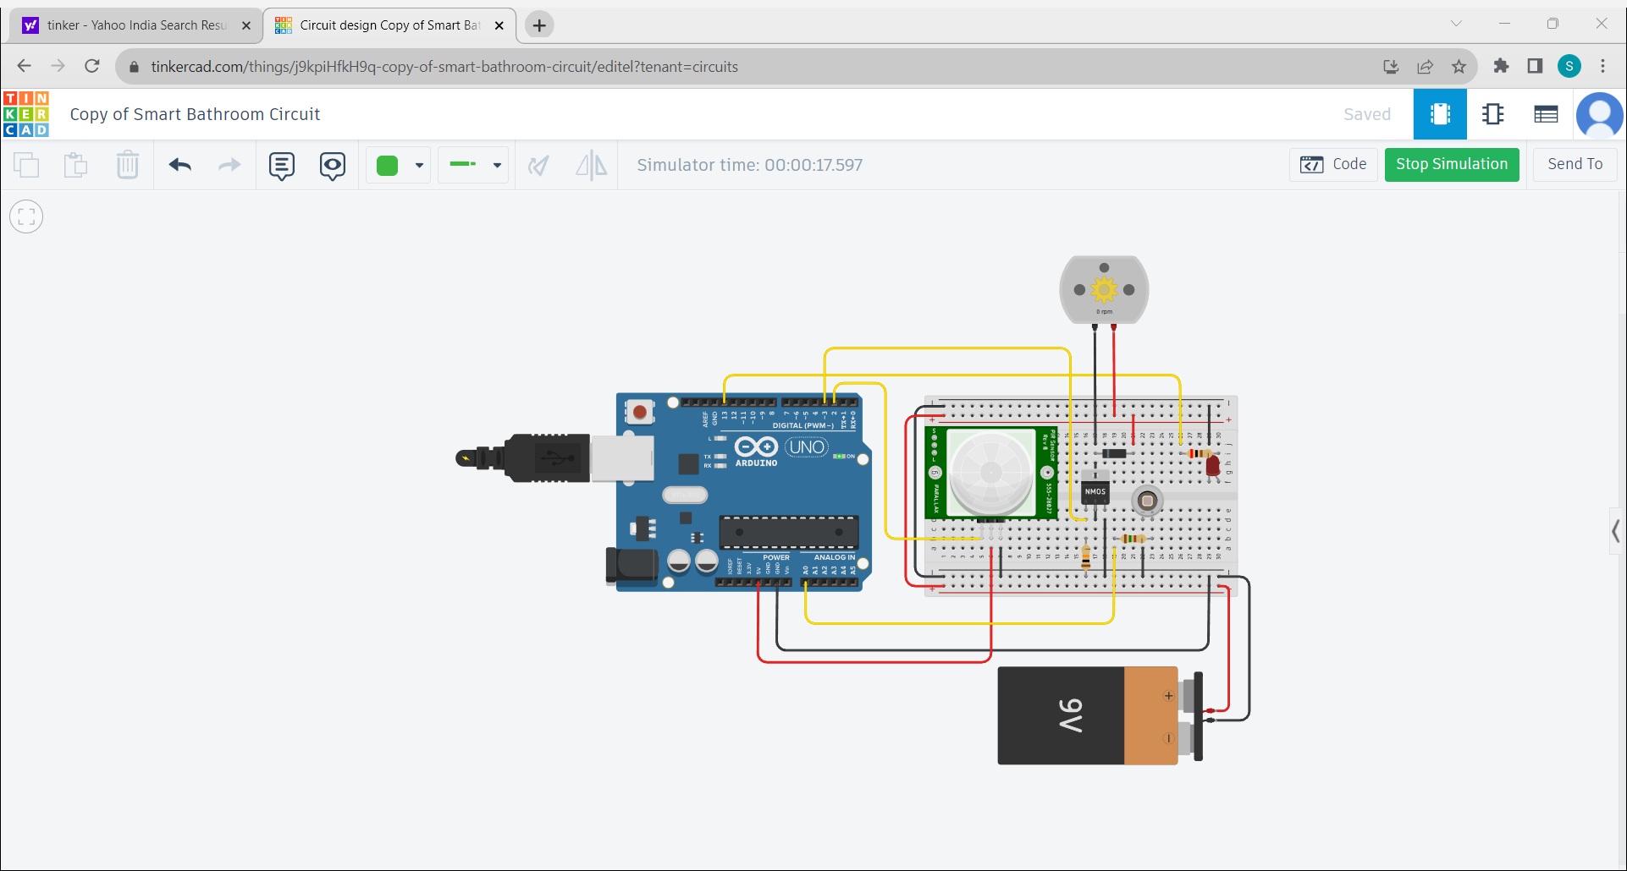
SIMULATIONS:

Slide 16
Conclusion:
Overall, smart washroom solution is one of those IoT solutions that enhance user experience, allow effectively manage workload, promote workers well-being, and take care of users’ health. Therefore, very soon, it will be hard to imagine a restroom not stuffed with sensors, indicators, and displays. We at Quinta group have expertise in IoT solutions development and are eager to make your home and life smarter. We are willing to contribute to world automation and be among those who generate and successfully implement IoT products using artificial intelligence, machine learning techniques, and LoRaWAN technology.
Our proposed project will create awareness among the people about the proper sanitation. It makes use of Internet of things, which is a rapidly growing technology. Our proposed system will make everyone to strictly follow the cleanliness and proper sanitation in the toilets. It prevents the many new contagious diseases that spread due to improper sanitation of the toilets. Thus by using technologies in the smarter way, we can maintain the cleanliness which is next to the godliness. Keep Clean, Be Safe.

Slide 17
Thank you

